Slide 1
World War 2 Propaganda Poster Activity

Slide 2
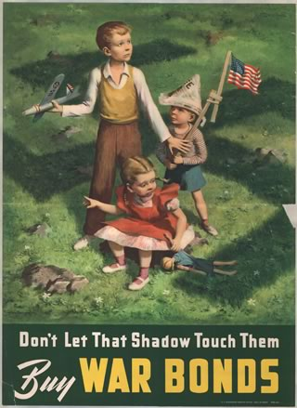
Message in propaganda posters:
Men- patriotism, revenge, masculinity, to volunteer
Women- to fear for family’s safety, take on a new role, conserve
Children- victory gardens, recycle, help ration
General Public- aimed at peoples emotions, prepare them to sacrifice, encourage support for the country

Slide 3
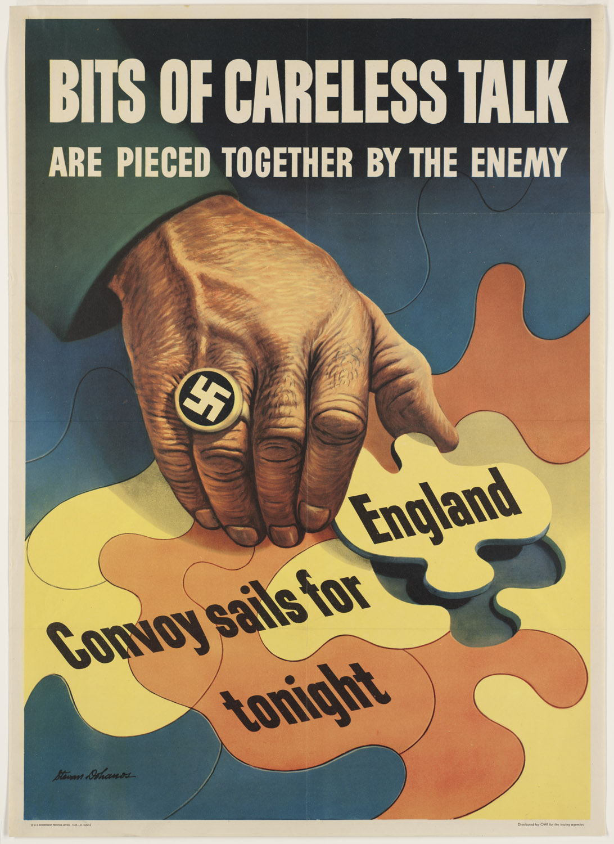
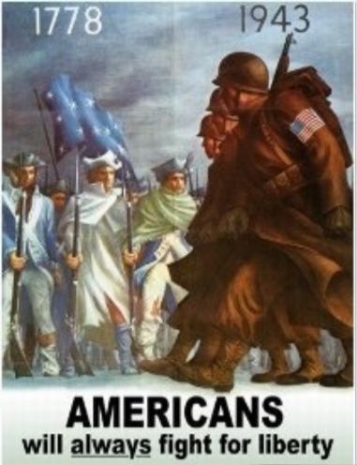
Analysis of a poster
What is the message in the poster?
What characteristics make the posters message effective?
How is the enemy portrayed in the poster?
What group of people is the poster trying to reach?
How well does the poster communicate the message to the audience?

Slide 4
Propaganda Poster Project
Create a propaganda poster based on your knowledge of World War II in Georgia Studies.
Your poster can be geared towards any audience (ie. Men, Women, Children, the public) and reference an aspect of the war (i.e. rationing, enlisting, patriotism, factory jobs, war bonds, gossip, etc.)
Your poster must relate to Georgia. Choose one of the following topics: Savannah or Brunswick Shipyards, Lend-Lease Act, Bell Aircraft, Ft. Benning)
Your poster should contain 2 lines of text or captions related to the poster theme.
Answer a questions sheet provided about their poster.

Slide 5
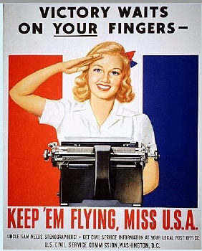
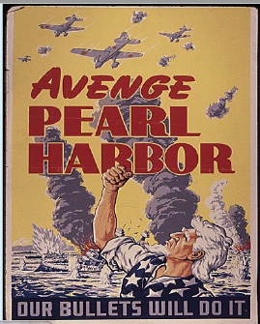
World War II Propaganda poster examples:

Slide 6
Name:
What is the message in the poster?
2. What characteristics make the posters message effective?
3. How is the enemy portrayed in the poster?
4. What group of people is the poster trying to reach?
5. Why do you think propaganda needed to mobilize Americans?

