Slide 1
SS8H12
Modern
Georgia
© 2015 Brain Wrinkles

Slide 2
Standards
SS8H12 The student will explain the importance of developments in Georgia since the late 20th century.
a. Explain how the continued development of Atlanta under mayors Maynard Jackson and Andrew Young impacted the state
c. Evaluate the short-term and long-term impacts of hosting the 1996 Olympic on Georgia’s economic and population growth.
d. Analyze Georgia’s role in the national and global economy of the 21st Century, with regards to tourism, Savannah port expansion, and the film industry.
© 2015 Brain Wrinkles

Slide 3
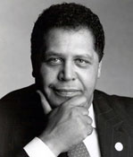
Maynard Jackson
In 1973, Maynard Jackson made history when he was elected as Atlanta’s first African American mayor.
As mayor, Jackson made sure that minority businesses received a fair share of city contracts, often upsetting established white business owners.
Under his leadership, MARTA (Atlanta’s mass transit system) began running and Hartsfield Airport added a new international terminal that helped the economy.
The city of Atlanta added his name to the airport in 2003: Hartsfield-Jackson Airport.
© 2015 Brain Wrinkles

Slide 4
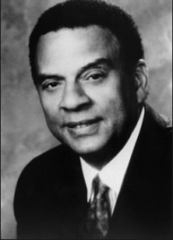
Andrew Young
Andrew Young became well known as a civil rights activist and aide to Martin Luther King, Jr.
In 1972, he won a seat in Congress and was Georgia’s first African American representative to the House since Reconstruction.
In 1977, President Carter appointed Young to be America’s ambassador to the United Nations.
In 1981, he succeeded Jackson as Atlanta’s mayor.
© 2015 Brain Wrinkles

Slide 5
Andrew Young
Young served two successful terms as mayor, where he increased international investment in the city and brought the 1988 Democratic Convention to Georgia.
He ran for governor in 1990, but lost to Zell Miller.
Young played a key role in bringing the 1996 Olympic Games to Atlanta.
© 2015 Brain Wrinkles

Slide 6
Atlanta 1996
In 1996, Atlanta hosted the Centennial Summer Olympic Games.
The festivities not only honored the hundredth anniversary of the modern Olympics but also brought recognition and investment to Georgia from all over the world.
With the opening of the Games, Atlanta welcomed 197 nations, as well as countless spectators to the city.
© 2015 Brain Wrinkles

Slide 7
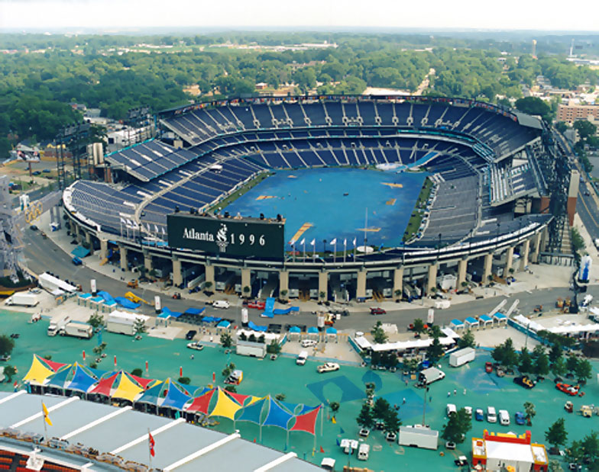
Atlanta 1996
Existing sports venues were expanded and additional venues were constructed not only throughout the city, but also throughout the state and other surrounding states.
Downtown Atlanta was revamped with new sidewalks, trees, and lights, and the 21-acre Centennial Park was developed in the heart of the city.
The Olympic Stadium became the new home for the Atlanta Braves.
New dormitories were built for Olympic athletes and are now used by state universities.
© 2015 Brain Wrinkles

Slide 8
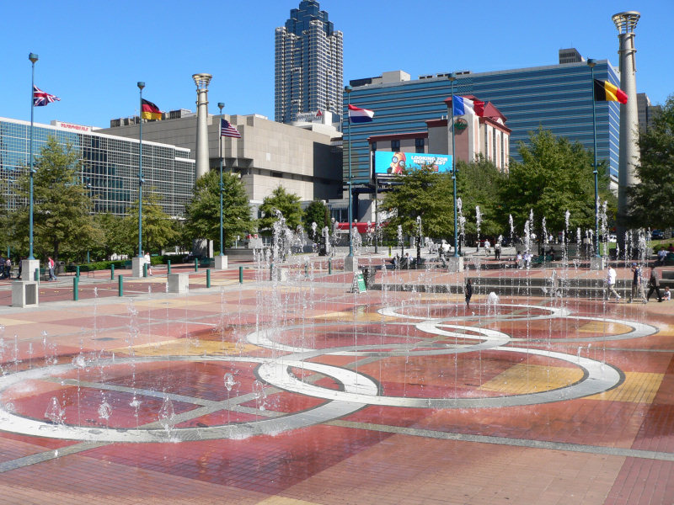
Impact
The city of Atlanta and the entire state of Georgia benefitted economically from hosting the Olympics.
The estimated impact of the Olympics on Atlanta was over five billion dollars, and much of Georgia’s economic fortune today is a result of the Centennial Olympic games.
The Olympics also established Atlanta’s reputation as a excellent place for tourism, commerce, and sports.
© 2015 Brain Wrinkles

Slide 9
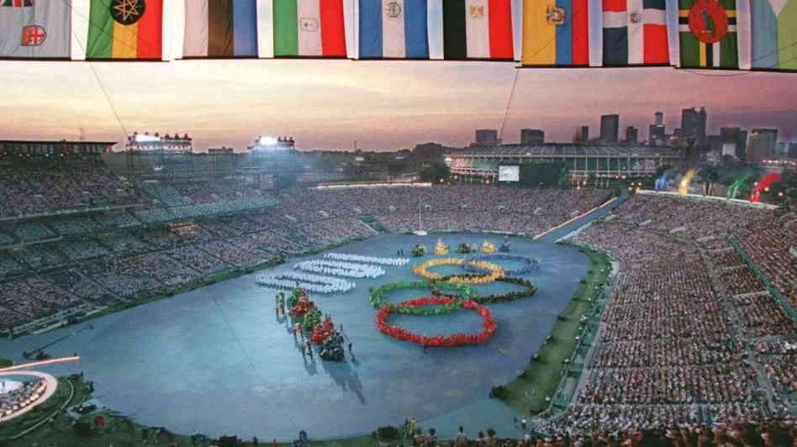
Benefits
New jobs and facilities were created throughout the state for the Olympics.
The government increased its revenue through taxes, which was then spent on providing services and programs for Georgia’s citizens.
Since the Olympics, many businesses have relocated to Georgia to take advantage of Atlanta being in international city.
© 2015 Brain Wrinkles

Slide 10
How did the 1996 Olympics affect Atlanta and the state of Georgia?
Economic
Growth
Jobs
Sports
Facilities
Tax
Revenue
Global
Exposure
(Tourism)
© 2015 Brain Wrinkles

Slide 11
Immigrants
Georgia’s economy has grown tremendously since the 1990s, partly due to new immigrant communities within the state.
Georgia’s foreign-born population has increased from 1990 to 2000 by 233%.
More than 50% of Georgia’s immigrants came from Mexico and other Latin American countries.
© 2015 Brain Wrinkles

Slide 12
Impact
Legal immigrant communities provide low-cost labor, particularly in northern Georgia’s construction, poultry processing, and carpet manufacturing industries.
This helps businesses grow while providing cheaper goods and services for consumers.
New immigrant communities also increase the cultural diversity of an area.
© 2015 Brain Wrinkles

Slide 13
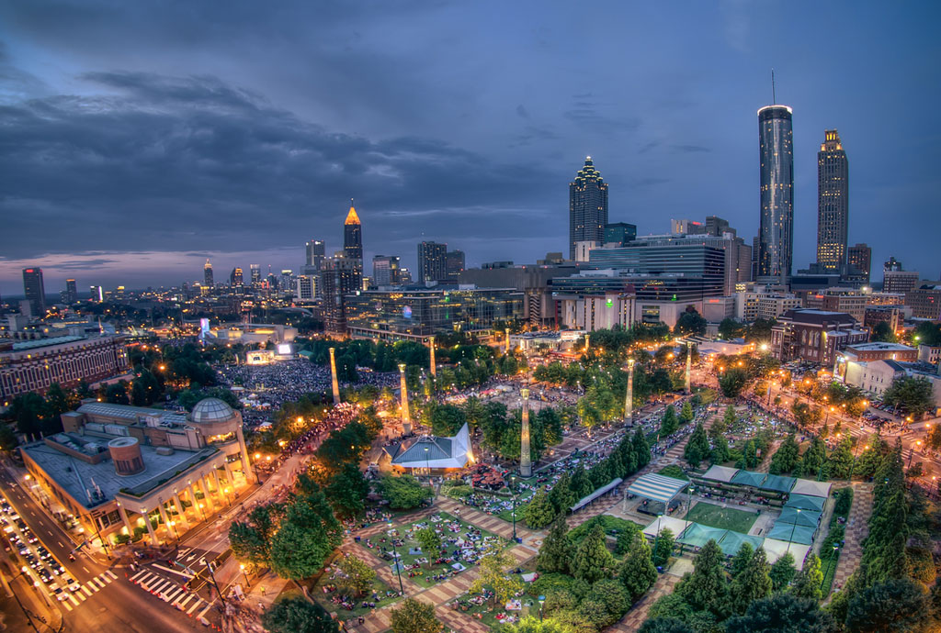
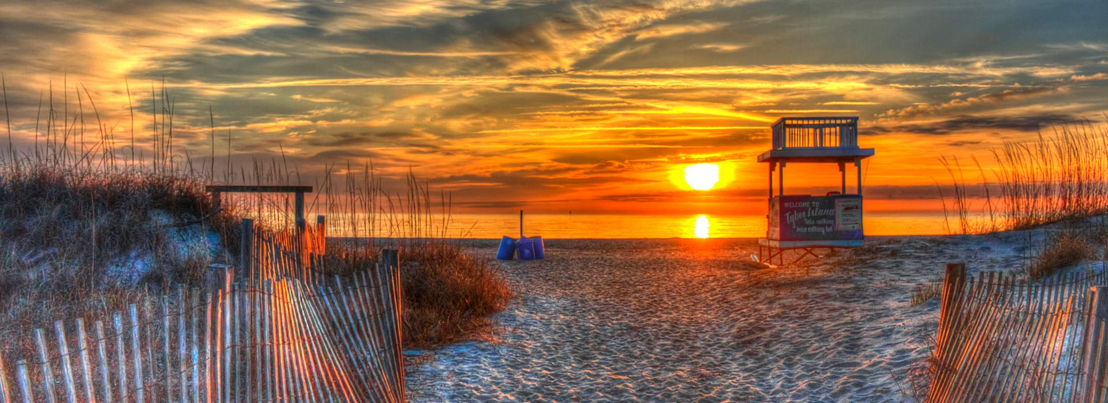
Tourism
Tourism is one of Georgia’s largest industries.
Popular destinations include Georgia’s Mountains, Costal Georgia, and cities such as Savannah and Atlanta
Tourism has become one largest employers and sources of revenue for the state
© 2015 Brain Wrinkles

Slide 14
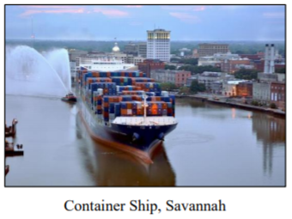
Savannah Harbor
Savannah’s port is the 4th busiest container port in the U.S. and the fastest growing port in the US.
The Savannah Harbor Expansion project is now underway, which will deepen the harbor 49 feet.
The new locks will be able to accommodate ships 3 times the size of what it can currently hold
The expansion will allow for more business in Savannah, generate more jobs, and more revenue for the state.
© 2015 Brain Wrinkles

Slide 15
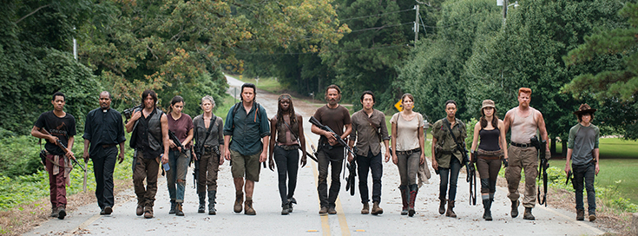
Film Industry
Georgia has a rapidly growing film industry that is ranked 3rd in the country.
This is due to financial incentives, diverse filming locations, and production resources
The climate allows for year round filming and the airport allows for easy accesses in and out of the state.
© 2015 Brain Wrinkles

Slide 16
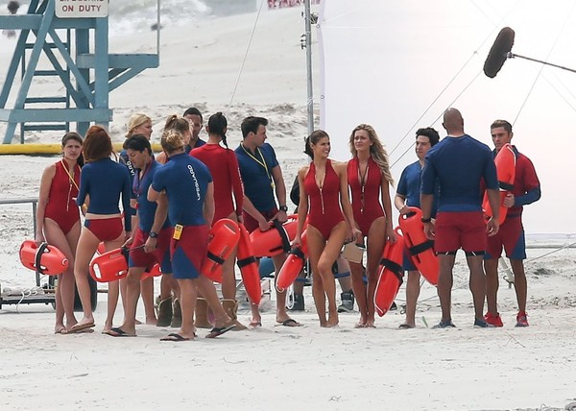
Film Industry
The film industry creates large amounts of revenue, jobs, and supports several arts colleges in the state.
Georgia is also home to Tyler Perry Studios and Turner broadcasting, both produces movies and television shows.
CNN is also headquartered in Atlanta and is a major leading cable news network
© 2015 Brain Wrinkles

