Slide 1
Georgia’s Government
LEGISLATIVE
BRANCH
LEGISLATIVE
BRANCH
© Brain Wrinkles

Slide 2
STANDARDS:
S8CG2 Analyze the role of the legislative branch in Georgia.
a. Explain the qualifications for members of the General Assembly and its role as the law-making body of Georgia.
b. Describe the purpose of the committee system within the Georgia General Assembly.
c. Explain the process for making a law in Georgia
d. Describe how state government is funded and how spending decisions are made.
© Brain Wrinkles

Slide 3
Legislature
The legislative branch is the one that makes the laws, and according to separation of powers, no other branch has the right to make Georgia’s laws.
In Georgia, the General Assembly acts as the state’s legislative branch of government.
It consists of two houses: the House of Representatives and the Senate.
Under Georgia’s Constitution, the House must have at least 180 members and the Senate must have at least 56.
© Brain Wrinkles

Slide 4
Georgia State Capitol – Atlanta
Home of General Assembly
© Brain Wrinkles

Slide 5
© Brain Wrinkles

Slide 6
Qualifications
In order to serve in the General Assembly, individuals must meet certain qualifications.
Qualifications for legislators in both Houses include US citizenship, Georgia citizenship for at least two years, and legal residence in their districts for at least one year.
Senators must be at least 25 years old and representatives must be 21.
Someone who is currently serving in the military is not allowed to be either a senator or representative.
© Brain Wrinkles

Slide 7
Terms & Elections
Members of both houses of the General Assembly serve two-year terms with no limit on consecutive terms.
General Assembly members are elected in general elections in their local districts.
The entire membership of each body is elected at the same time and elections occur in even numbered years.
© Brain Wrinkles

Slide 8
Duties
The legislative session begins on the second Monday in January and lasts for 40 days.
For the rest of their two-year terms, the duties of senators and representatives take place in special sessions and committees.
Members work on making laws to ensure the welfare of citizens, proposing Georgia’s budget, and amending the constitution.
© Brain Wrinkles

Slide 9
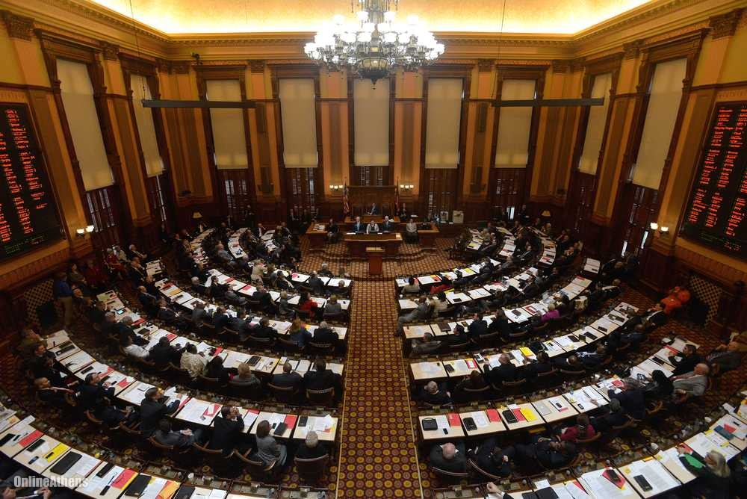
Georgia Senators
© Brain Wrinkles

Slide 10
Duties
While many legislative powers are shared by the House and Senate, some powers are reserved for one house but not the other.
Only the House of Representatives may introduce bills designed to raise revenue, appropriate funds, or impeach.
Only the Senate may determine the guilt or innocence of impeached officials or approve/reject appointments by the governor.
© Brain Wrinkles

Slide 11
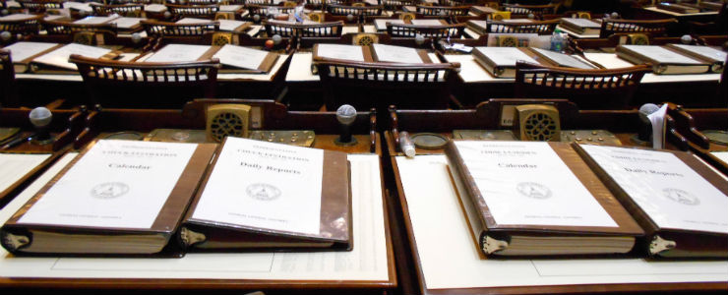
© Brain Wrinkles

Slide 12
Leadership
The speaker of the House acts as the head of the House of Representatives.
Members of the House elect him/her from among their members.
The lieutenant governor presides over the Senate.
Georgians elect him/her in a statewide election by popular vote.
The Senate elects a president pro tempore and the House elects a speaker pro tempore to serve in place of the lieutenant governor and speaker when they are absent.
The Senate also has a secretary of the Senate and the House a clerk of the House of Representatives.
© Brain Wrinkles

Slide 13
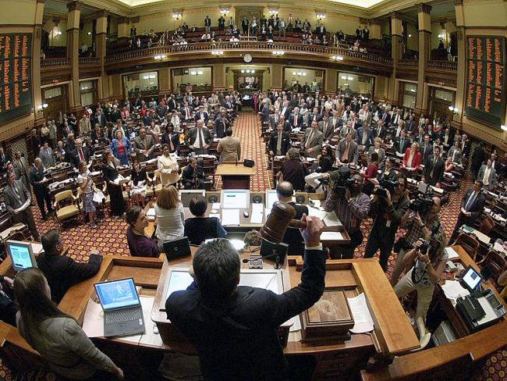
© Brain Wrinkles

Slide 14
Committees
Both the speaker of the House and the lieutenant governor appoint committees that focus on different issues and make recommendations about specific bills.
The committee system is an important part of the legislative process as much of the work done in Georgia’s General Assembly takes place in committees.
Both houses use committees to study bills before they are sent to the members for debate and vote.
© Brain Wrinkles

Slide 15
Committees
There are about 36 regular committees in the House of Representatives.
Each representative sits on 2-3 committees that deal with things such as public safety, education, agriculture, transportation, etc.
There are about 26 committees in the Senate.
Each Senator is a member of at least three committees, and the lieutenant governor chooses each committee’s chair.
© Brain Wrinkles

Slide 16
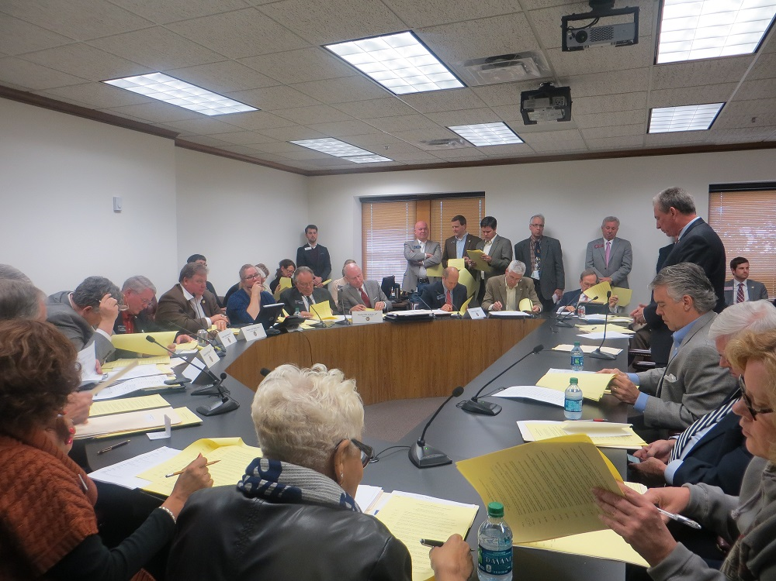
Senate Rules Committee
© Brain Wrinkles

Slide 17
Bill to Law
In order for a bill to become a law, it must go through a specific legislative process.
Drafting – With the help of lawyers, legislators write the text of the bill.
Introduction – Either a senator or representative introduces the bill to the house s/he belongs to.
Committee Consideration – The committee studies the bill and decides whether or not it should become a law.
© Brain Wrinkles

Slide 18
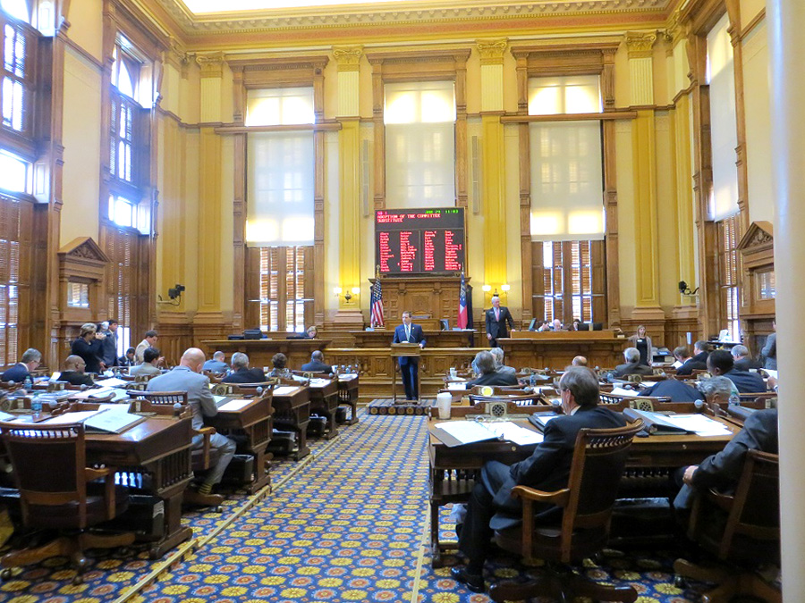
© Brain Wrinkles

Slide 19
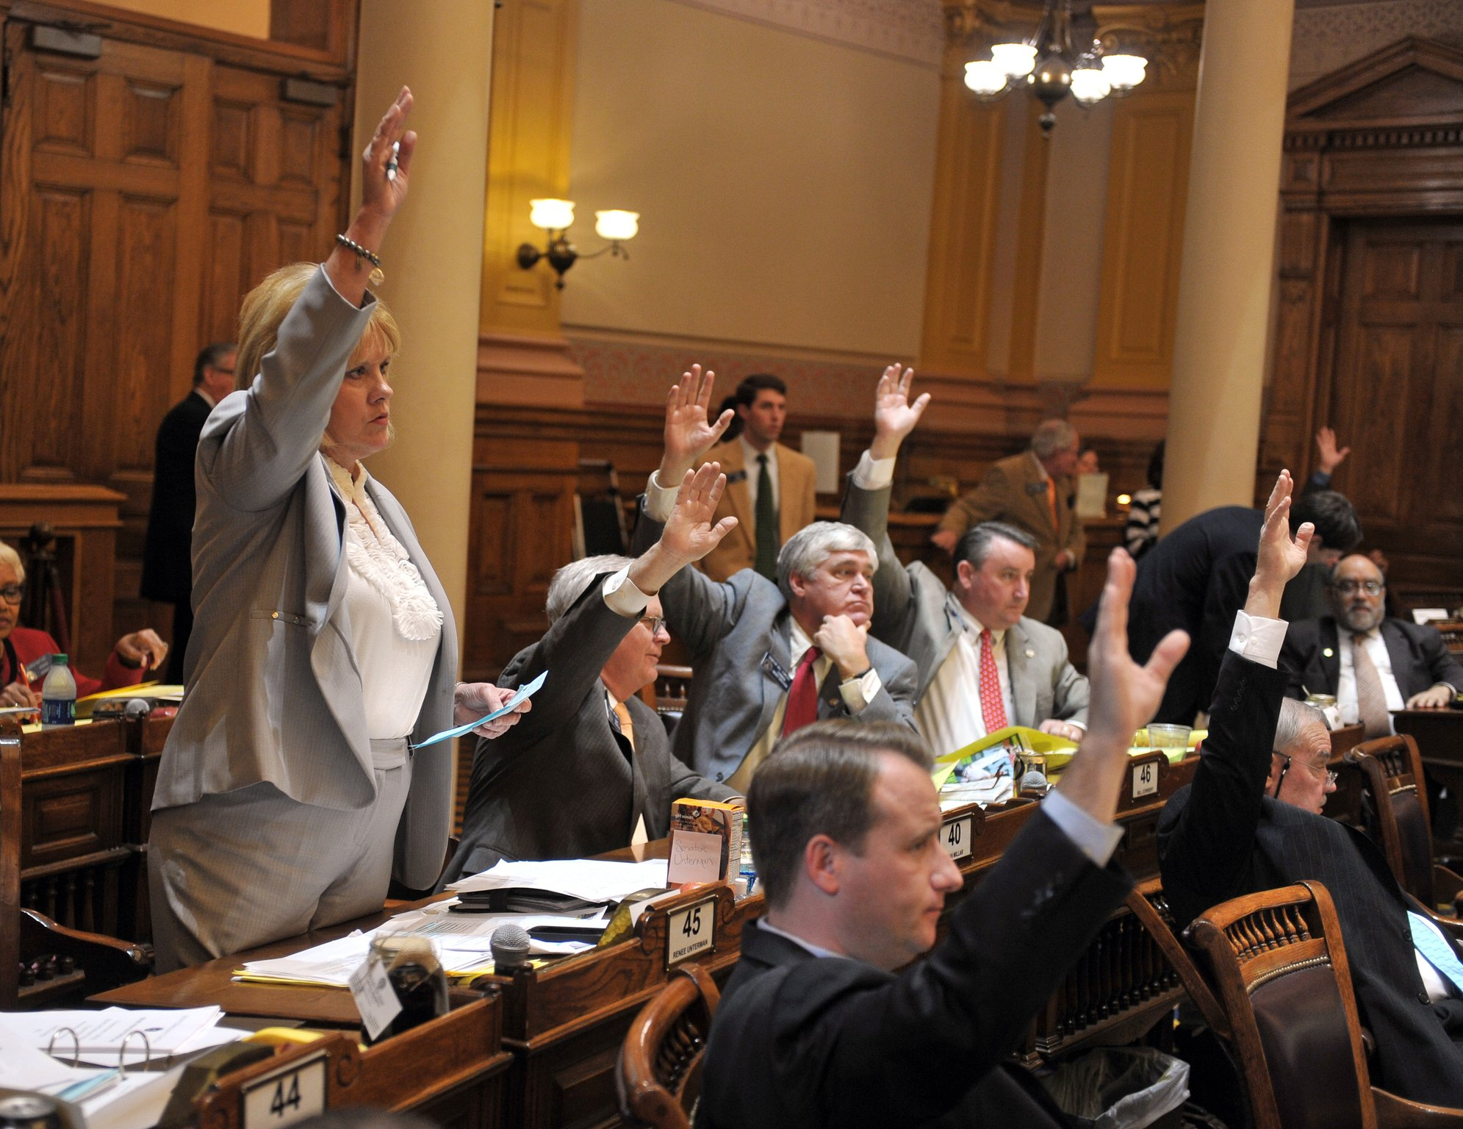
© Brain Wrinkles

Slide 20
Bill to Law
Floor Consideration – The bill is read aloud in either the House or the Senate and members vote on the bill. If the majority votes “no”, then the bill dies. If the majority votes “yes”, then the bill goes to the other house where the process is repeated.
Governor Consideration – A bill that passes both houses is sent to the governor. The governor can sign the bill and it becomes a law, or veto the bill. It then goes back to the General Assembly for reconsideration. They can override the governor’s veto with a two-thirds vote in both houses.
4.
5.
© Brain Wrinkles

Slide 21
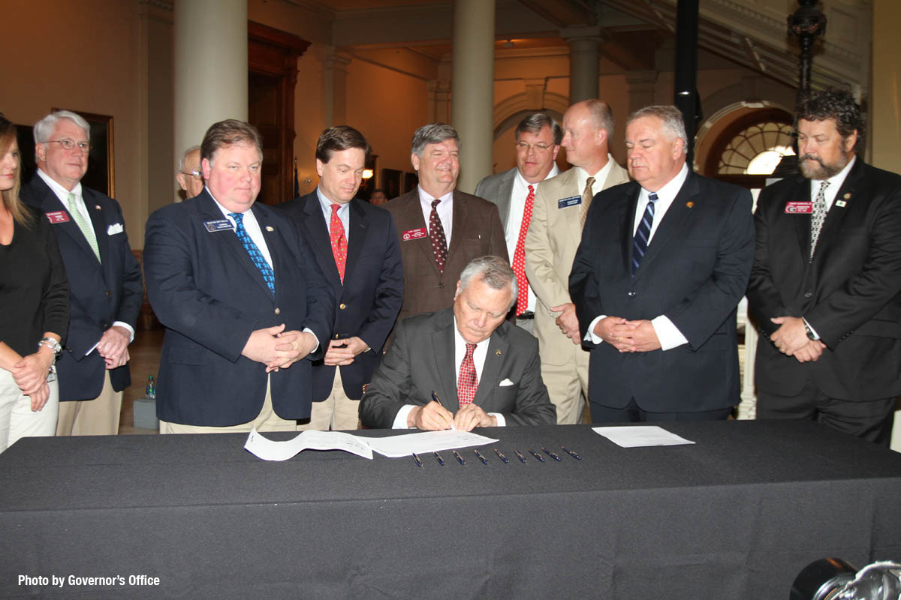
© Brain Wrinkles

Slide 22
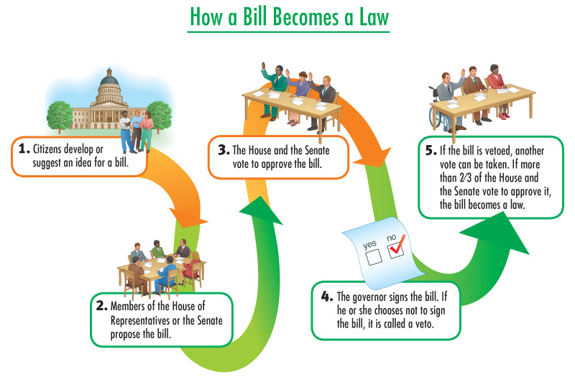
© Brain Wrinkles

Slide 23
Funding & Spending
In order for the state government to function effectively, the government must generate revenue (money) to operate and meet the needs of citizens.
The General Assembly determines the types of revenue sources and the terms by which they will be used.
The Department of Revenue, and agency of the state government, is given the responsibility of collecting and giving out money generated by the state.
Georgia’s government collects tax and non-tax revenues
© Brain Wrinkles

Slide 24
Funding & Spending
Tax Revenues | Non-Tax Revenues
Individual Income Taxes Corporate Income Taxes Insurance Premium Taxes General Sales Taxes Property Taxes Excise Taxes Estate (Inheritance) taxes | Fees The State Lottery Settlement Programs
© Brain Wrinkles

