Slide 1
SS8H12b
Jimmy
Carter
Senator, Governor,
& President
© 2015 Brain Wrinkles

Slide 2
Standards
SS8H12 The student will explain the importance of developments in Georgia since the late 20th century.
b. Describe the Role of Jimmy Carter in Georgia as state governor, president, and past president.
© 2015 Brain Wrinkles

Slide 3
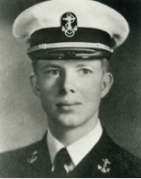
Early Life
James Earl Carter, Jr. was born on October 1, 1924 in Plains, Georgia.
Carter had a military career in the Navy, but returned home to Plains after his father passed away.
Jimmy, his wife Rosalynn, and their four kids managed the family peanut farm.
© 2015 Brain Wrinkles

Slide 4
Senator
Carter began his political career in 1962 when he won the state senate position for the 14th District of Georgia.
He served two terms in the State Senate and promoted the need for reorganizing Georgia’s system while in office.
© 2015 Brain Wrinkles

Slide 5
Governor
In 1970, Jimmy Carter won the governor’s race and quickly began to create a “new Georgia”.
In his inaugural address, he informed Georgians that it was time for segregation to end.
Carter favored integration and often butted heads with his lieutenant governor, Lester Maddox, over promoting civil rights.
© 2015 Brain Wrinkles

Slide 6
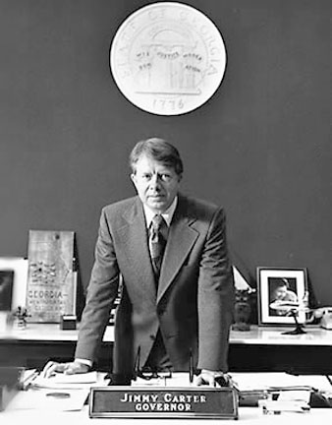
In his inaugural speech, Carter stated, “No poor, rural, weak, or black person should ever have to bear the additional burden of being deprived of the opportunity of an education, a job, or simple justice.”
© 2015 Brain Wrinkles

Slide 7
Governor
Carter used his four years in office to restructure the entire state government and completely change the format of the state budget.
He also pushed for reforms of Georgia’s education, mental health, and criminal justice systems.
Carter also favored business and industrial growth in Georgia.
© 2015 Brain Wrinkles

Slide 8
President
In the 1976 election, Carter defeated incumbent Republican President Gerald Ford to become the 39th president of the United States.
President Carter served from 1977 to 1981 and created several new programs and departments that are still a fundamental part of the federal government today.
© 2015 Brain Wrinkles

Slide 9
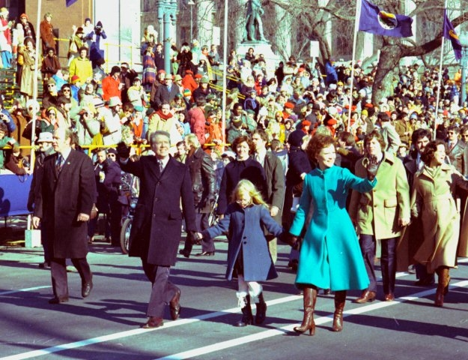
On inauguration day, President Carter and his family walk down Pennsylvania Avenue.
© 2015 Brain Wrinkles

Slide 10
Camp David Accords
For centuries, Arabs and Jews have fought over land in the Middle East.
President Carter invited Egypt’s president and Israel’s prime minister to Camp David (the president’s personal retreat) to try to work out a peace agreement.
On September 17, 1978, the leaders negotiated a peace treaty and signed the Camp David Accords.
Many saw this as a diplomatic miracle and Carter was given credit for his role in negotiating the agreement.
© 2015 Brain Wrinkles

Slide 11
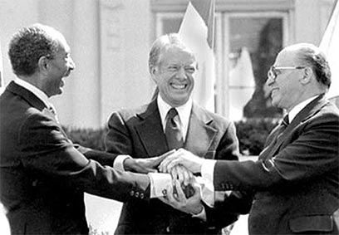
On 17th September 1978, Sadat and Begin signed a document entitled "The Framework for Peace in the Middle East”, also known as the Camp David Accords.
© 2015 Brain Wrinkles

Slide 12
Soviets
After Carter exercised his foreign policy in the Middle East, he established the SALT II nuclear limitation treaty with the Soviet Union which limited the number of nuclear weapons held by the US and the USSR.
Not long after agreeing to the terms, the Soviets ignored the agreement and invaded Afghanistan.
President Carter responded with a grain embargo and a boycott of the 1980 Olympic Games in Moscow; however, many Americans questioned whether he was capable of being tough enough with the Soviets.
© 2015 Brain Wrinkles

Slide 13
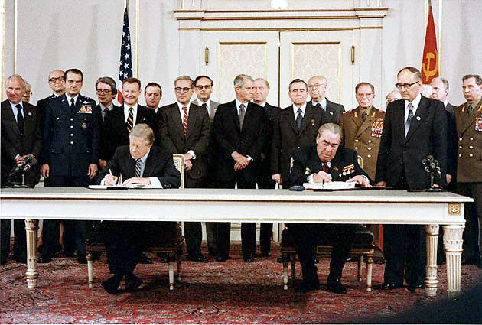
Carter & Brezhnev sign SALT II - 1979
© 2015 Brain Wrinkles

Slide 14
Iran Hostage Crisis
Even more damaging for Carter’s presidency was the Iran Hostage Crisis.
In 1979, Iranian students captured the US embassy in Tehran and took those inside hostage.
The students were angry at Carter for allowing Iran’s former leader to enter the US for medical treatment.
They demanded the Shah be returned to Iran in exchange for the hostages.
© 2015 Brain Wrinkles

Slide 15
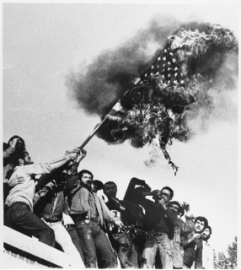
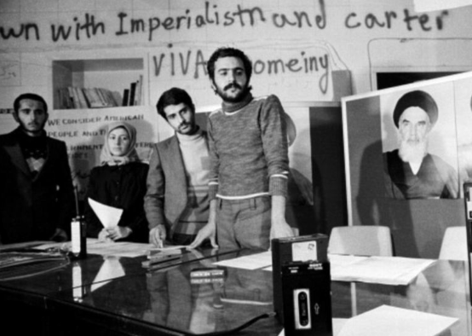
Iranian students storm
US embassy
© 2015 Brain Wrinkles

Slide 16
Iran Hostage Crisis
Carter refused the exchange and the crisis continued.
Five months later, Carter authorized a rescue attempt that failed when a military helicopter crashed into a transport plane, killing several US soldiers.
Americans were angry and blamed President Carter for not taking better control of the event.
When Carter lost the 1980 election, the Iranians agreed to let the hostages go.
© 2015 Brain Wrinkles

Slide 17
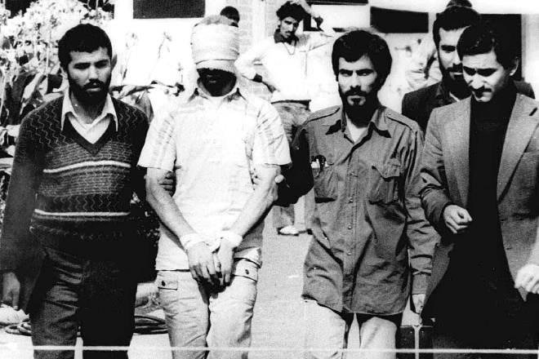
The 52 hostages were released within hours of Carter leaving office.
© 2015 Brain Wrinkles

Slide 18
Post-Presidency
While his approval ratings may not have been high as president, Carter has become one of the most admired ex-presidents in history.
Carter has worked to promote democracy and human rights around the world, and has often been called on to represent the US in diplomatic efforts.
He built the Carter Center in Atlanta in 1982, and it works to fight diseases and starvation throughout the world.
The Center has also monitored over 80 elections in 34 countries to ensure fair and balanced results and provided additional assistance to the democratic process.
© 2015 Brain Wrinkles

Slide 19
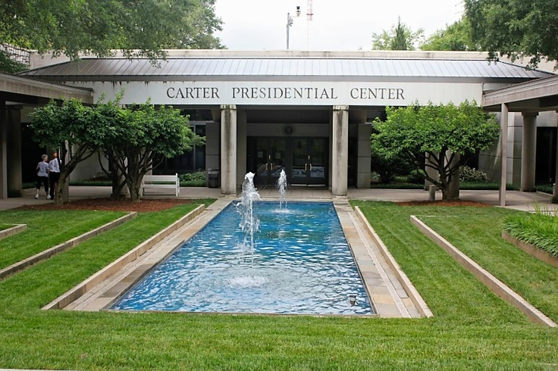
© 2015 Brain Wrinkles

Slide 20
Nobel Prize
For his dedication to humanitarian efforts and ending international conflict, Carter was awarded the Nobel Peace Prize in 2002.
The award is given to the person whose work has most benefited mankind.
© 2015 Brain Wrinkles

Slide 21
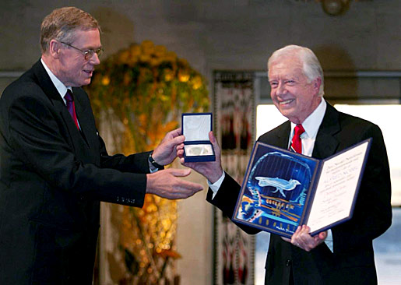
Jimmy Carter receives Nobel Peace Prize.
© 2015 Brain Wrinkles

