Slide 1
Georgia’s
Constitution
© Brain Wrinkles

Slide 2
STANDARDS:
SS8CG1 The student will describe the role of citizens under Georgia’s constitution.
a. Explain the basic structure of the Georgia state constitution (preamble, bill of rights, articles, and amendments) as well as its relationship to the United States Constitution.
b. Explain separation of powers and checks and balances among Georgia’s three branches of government.
c. Describe the rights and responsibilities of citizens according to the Georgia Constitution.
d. List voting qualifications and elections in Georgia.
e. Identify wisdom, justice, and moderation as the three principles of the Pledge of Allegiance to the Georgia Flag.
© Brain Wrinkles

Slide 3
Constitution
A constitution establishes the relationship between a government and its people.
The structure and powers of state government are defined by the state constitution.
Georgia’s government has operated under 10 different constitutions, beginning in 1777.
The current constitution was ratified in 1983.
© Brain Wrinkles

Slide 4
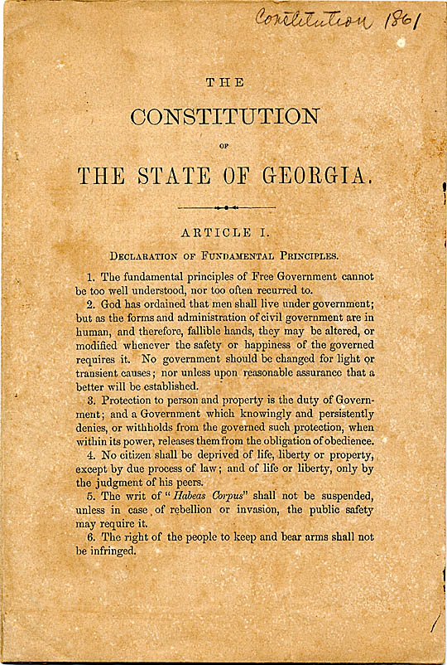
© Brain Wrinkles

Slide 5
The Set Up
The Georgia Constitution is based on many of the same principles as the United States Constitution and is structured similarly.
It begins with a preamble and is followed by eleven articles that address the different branches and duties of government.
© Brain Wrinkles

Slide 6
Preamble
Georgia’s preamble is a short paragraph that states the purpose of the constitution and gives the reasons for its existence.
Georgia’s Preamble:
“To perpetuate the principles of free government, insure justice to all, preserve peace, promote the interest and happiness of the citizen and of the family, and transmit to posterity the enjoyment of liberty, we the people of Georgia, relying upon the protection and guidance of Almighty God, do ordain and establish this Constitution.”
© Brain Wrinkles

Slide 7
Articles
Article I – Bill of Rights
Article II – Voting and Elections
Article III – Legislative Branch
Article IV – Constitutional Boards & Commissions
Article V – Executive Branch
Article VI – Judicial Branch
Article VII – Taxation and Finance
Article VIII – Education
Article IX – Counties & Municipal Corporations
Article X – Amendments to the Constitution
Article XI – Miscellaneous Provisions
© Brain Wrinkles

Slide 8
Article I
Article I contains the state’s Bill of Rights.
This article states the specific rights of citizens and the government’s limits.
Some of these rights include: right to life, liberty, and property, freedom of speech, freedom of the press, and the right to defend oneself in court.
The United States Constitution and the Georgia Constitution both have a Bill of Rights.
© Brain Wrinkles

Slide 9
Article X
Article X describes the process to amend Georgia’s Constitution.
It may be amended in two ways.
First, through Proposals by the General Assembly.
A state senator or representative must introduce the proposed amendment and if two-thirds of both houses accept the change, then it goes before the people for a vote. If the majority of voters ratify the amendment, it becomes part of the constitution.
© Brain Wrinkles

Slide 10
Article X
The second way is by constitutional convention.
If two-thirds of each house of the General Assembly agrees to call such a convention, then delegates to the convention will meet to discuss and vote on possible changes to the constitution.
If the convention votes in favor of a proposed amendment, then the amendment goes before the citizens for a vote.
It becomes part of the Constitution if a majority of the voters vote in favor of the change.
© Brain Wrinkles

Slide 11
3 Branches
Like the government of the United States, Georgia’s government is divided into three different parts.
Each branch has a different role, which is called separation of powers.
The legislative branch (General Assembly) makes the laws that citizens must obey.
The executive branch (governor) is the head of the government who enforces the laws.
The judicial branch (courts) interprets the laws.
© Brain Wrinkles

Slide 12
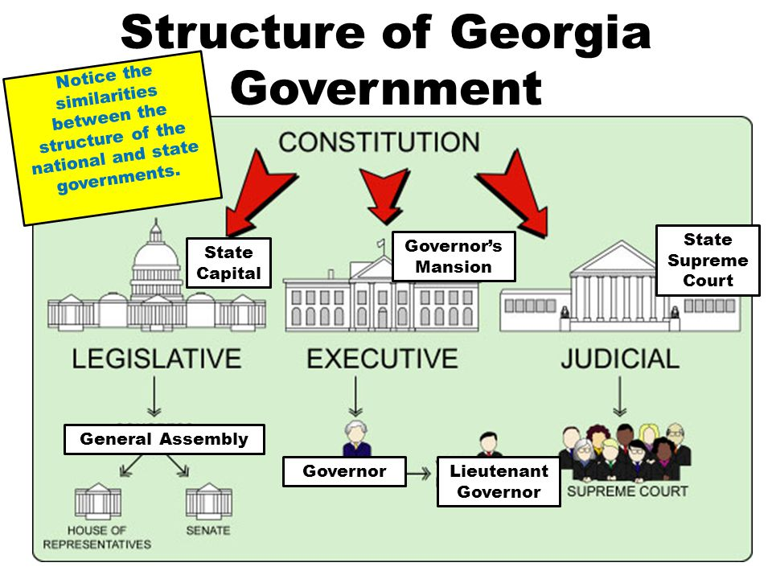
© Brain Wrinkles

Slide 13
Checks & Balances
So that one branch doesn’t become too powerful, the branches put limits, or checks, on each other.
If one branch makes an error, another branch can set it right, or balance it.
This system of limiting the roles of each branch and setting right another branch’s error is called checks and balances.
© Brain Wrinkles

Slide 14
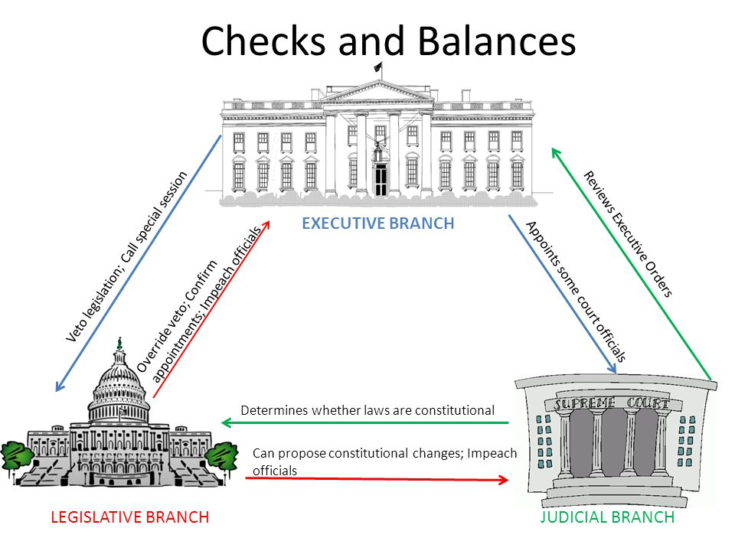
© Brain Wrinkles

Slide 15
Examples:
The governor cannot make laws, but s/he can veto a law passed by the legislature.
Only the governor can appoint public officials, but the Senate must approve them before they can take office.
The judicial branch may declare laws unconstitutional, in which case they are no longer laws.
© Brain Wrinkles

Slide 16
Rights
The US Constitution and the Georgia Constitution both give all citizens basic rights.
Rights are standards that keep institutions from harming people’s freedom.
The Bill of Rights in Georgia’s Constitution lists the rights of the citizens:
Right to freedom of speech and religion, right to keep and bear arms, right to trail by jury, right to a lawyer, etc.
© Brain Wrinkles

Slide 17
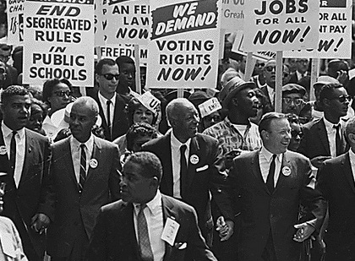
© Brain Wrinkles

Slide 18
Responsibilities
Along with rights come rules and responsibilities.
Laws made by the government protect people’s rights.
As citizens, we have responsibilities to take care of ourselves, respect the rights of others, and obey rules and laws.
© Brain Wrinkles

Slide 19
Examples:
The Constitution grants the right to freedom of religion; however, worship must obey the laws of the state. It cannot be immoral or harm people.
It also grants the right to bear arms, but people must obey the laws that deal with owning and carrying guns.
© Brain Wrinkles

Slide 20
Qualifications
Article II outlines the voting qualifications for elections:
You must be a citizen of the United States.
You must be a legal resident of Georgia and of the county where you wish to vote.
You must be at least 18 years of age.
A person cannot vote if s/he is serving a sentence for a felony conviction or has certain mental disabilities.
© Brain Wrinkles

Slide 21
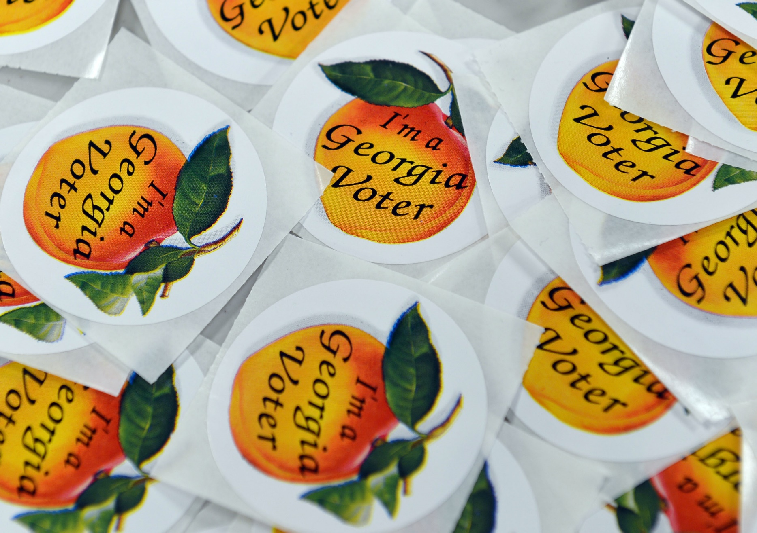
© Brain Wrinkles

Slide 22
Elections
Citizens register to vote on a county-by-county basis.
Voters cast their ballots at a specific location near their home.
Polling places are open from 7 am to 7 pm on Election Day, and employers are required to give their employees up to two hours to vote.
If you are unable to vote on Election Day, you can cast an absentee ballot by mail before the election.
© Brain Wrinkles

Slide 23
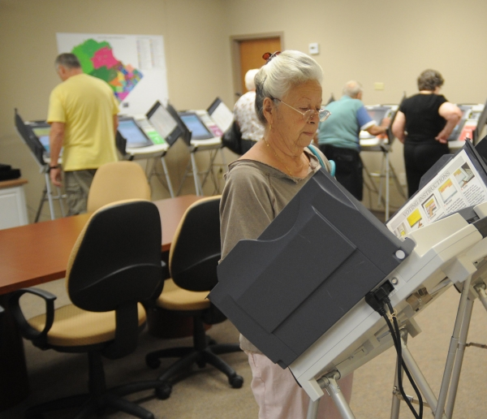
© Brain Wrinkles

Slide 24
Elections
Each fall, Georgians vote for a number of positions, depending on the year.
Every four years, citizens vote for officers in their county government.
Every two years, Georgians vote for members of the state’s General Assembly.
Every four years, there are elections for the governor and lieutenant governor.
On the national level, presidential elections are held every four years on the first Tuesday of November.
© Brain Wrinkles

Slide 25
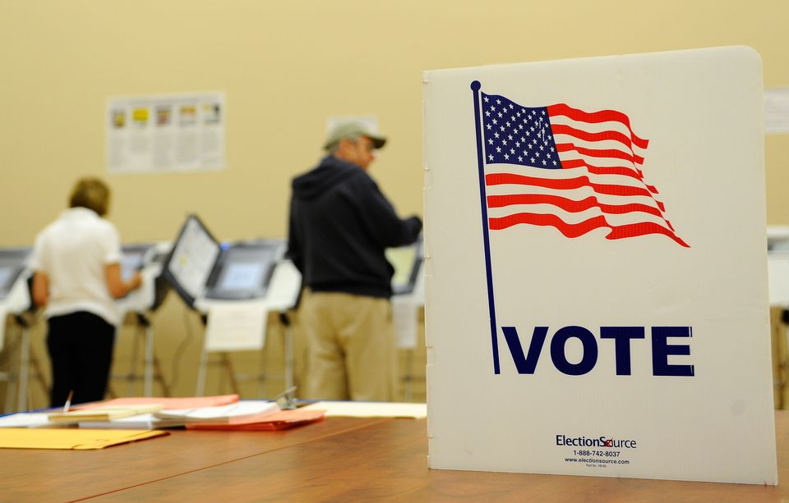
© Brain Wrinkles

Slide 26
State Flag
Georgia’s current state flag was adopted in 2003.
It has three red and white stripes and the state coat of arms is in the upper left corner on a blue background.
The coat of arms has an arch that symbolizes the constitution and three pillars that represent the legislative, judicial, and executive branches.
The words wisdom, justice, and moderation are wrapped around the pillars.
© Brain Wrinkles

Slide 27
© Brain Wrinkles

Slide 28
The Pledge
In 1935, the Georgia legislature adopted the Pledge of Allegiance to the Georgia Flag.
“I pledge allegiance to the Georgia flag and to the principles for which it stands: Wisdom, Justice, and Moderation.”
The three important principles of the Pledge of Allegiance are the same ones displayed on the coat of arms.
© Brain Wrinkles

Slide 29
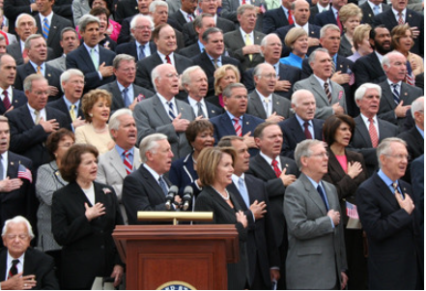
© Brain Wrinkles

Slide 30
3 Principles
Wisdom reminds the legislative branch to be wise in creating laws.
Justice appeals to the judicial branch for fair and just decisions.
Moderation urges the executive branch to carry out laws calmly within the boundaries of the law.
© Brain Wrinkles

Slide 31
What does Article I of Georgia’s Constitution focus on?
2. If someone wants to know about the structure of Georgia’s public education system, which article should he look in?
3. Which article describes the process to amend the Georgia Constitution?
4. Georgia’s General Assembly is which branch of government?
5. What does “checks and balances” mean?
6. Who is the highest official in Georgia’s government?
7. Name a basic right for citizens found in Georgia’s Constitution:
8. If you want to vote in Georgia, you must:
9. What are the two major political parties in Georgia’s politics?
10. What are the three important principles in the Pledge of Allegiance to Georgia’s flag?
© Brain Wrinkles
Government Comprehension Check

Slide 32
What does Article I of Georgia’s Constitution focus on?
Bill of Rights
2. If someone wants to know about the structure of Georgia’s public education system, which article should he look in?
Article VIII
3. Which article describes the process to amend the Georgia Constitution?
Article X
4. Georgia’s General Assembly is which branch of government?
Legislative
5. What does “checks and balances” mean?
The relationship between the executive, judicial, and legislative branches and how they limit each other from becoming too powerful or making mistakes
6. Who is the highest official in Georgia’s government?
Governor
7. Name a basic right for citizens found in Georgia’s Constitution:
Freedom of speech & religion, right to bear arms, right to fair trial, etc.
8. If you want to vote in Georgia, you must:
Be a US citizen, be 18, be a legal resident of Georgia, not be in prison or mentally disabled
9. What are the two major political parties in Georgia’s politics?
Republican and Democratic
10. What are the three important principles in the Pledge of Allegiance to Georgia’s flag?
Wisdom, Justice, and Moderation
© Brain Wrinkles
Government Comprehension Check
KEY

