Slide 1
Georgia’s Government
Executive
Branch
© Brain Wrinkles

Slide 2
STANDARDS:
SS8CG3 The student will analyze the role of the executive branch in Georgia state government.
a. Explain the qualifications for governor and lieutenant governor and their role in the executive branch of state government.
b. Describe how the executive branch fulfills its role though state agencies that administer programs and enforce laws.
© Brain Wrinkles

Slide 3
Qualifications
The executive branch is the largest branch and is responsible for enforcing Georgia’s laws.
The governor is the chief executive officer of the state and heads the executive branch.
In order to become governor, a candidate must:
Be at least 30 years old
Be a US citizen for at least 15 years
Be a Georgia resident for at least 6 years
© Brain Wrinkles

Slide 4
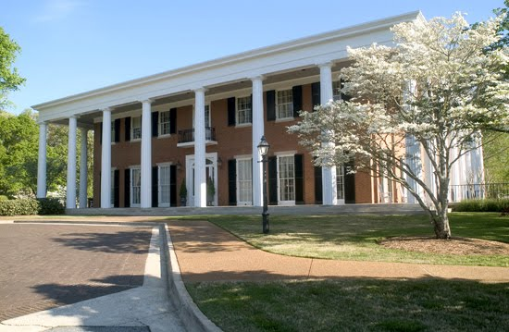
Georgia’s Governor’s Mansion
© Brain Wrinkles

Slide 5
Elections
To become governor, a candidate must win a statewide election by popular vote.
Once in office, s/he serves a four-year term, with a total of two consecutive terms allowed.
© Brain Wrinkles

Slide 6
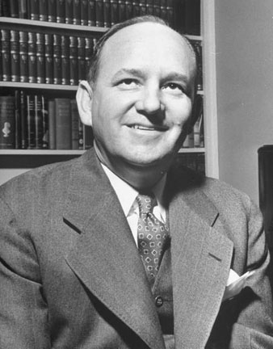
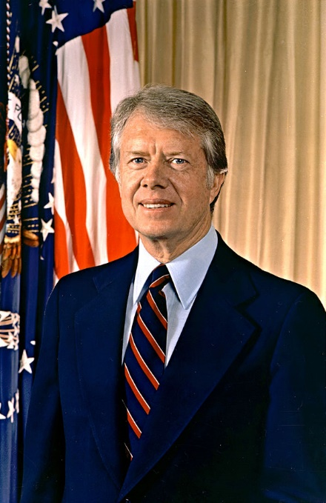
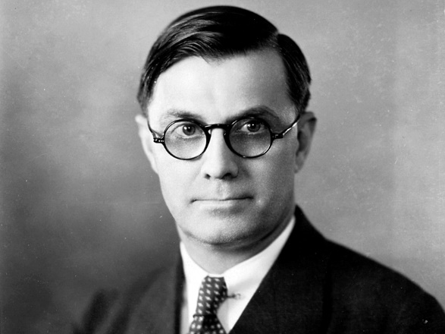
Jimmy Carter
Eugene Talmadge
Ellis Arnall
© Brain Wrinkles

Slide 7
Duties
The Georgia Constitution outlines the governor’s formal powers and duties.
They include enforcing laws, appointing people to state offices, signing bills into laws, suggesting new state programs and laws, and proposing and directing the state budget.
S/he also has the power to call special sessions of the legislature and can veto legislation.
The governor is also the commander-in-chief of Georgia’s military.
© Brain Wrinkles

Slide 8
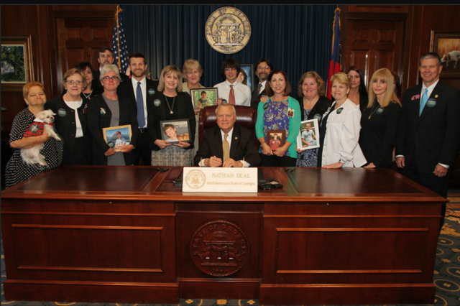
Governor Nathan Deal Signs 911 Alert Law
© Brain Wrinkles

Slide 9
Lt. Governor
The lieutenant governor serves as the state’s second highest ranking executive officer and is first in line to take the governor’s place.
Candidates must meet the same qualifications as governor.
The lieutenant governor is also elected by popular vote, but does not run on the same ticket as the governor.
S/he also serves a four-year term, but there is no limit on the number of terms.
© Brain Wrinkles

Slide 10
Lt. Governor
The lieutenant governor serves as governor if the current governor is unable to serve a complete term.
As president of the Senate, s/he decides committee memberships and chooses committee chairs.
The lieutenant governor is also responsible for any duties that which the governor assigns to her/him.
© Brain Wrinkles

Slide 11
State Agencies
In addition to governor and lieutenant governor, Georgians also elect other public officials who serve as part of the executive branch.
These officers are elected at the same time and serve the same term as the governor.
They include: the secretary of state, state attorney general, commissioner of agriculture, commissioner of labor, commissioner of insurance, and the state school superintendent.
These agencies oversee departments by developing policies and providing feedback to the governor so that state programs run smoothly and laws are enforced.
© Brain Wrinkles

Slide 12
Departments
The executive branch also includes a large number of state programs and departments that focus on major policy areas.
The governor appoints the leaders of the following departments.
Department of Education (DOE): Oversees Georgia’s public school system and how it is funded; certifies teachers, approves textbooks, and distributes funds.
© Brain Wrinkles

Slide 13
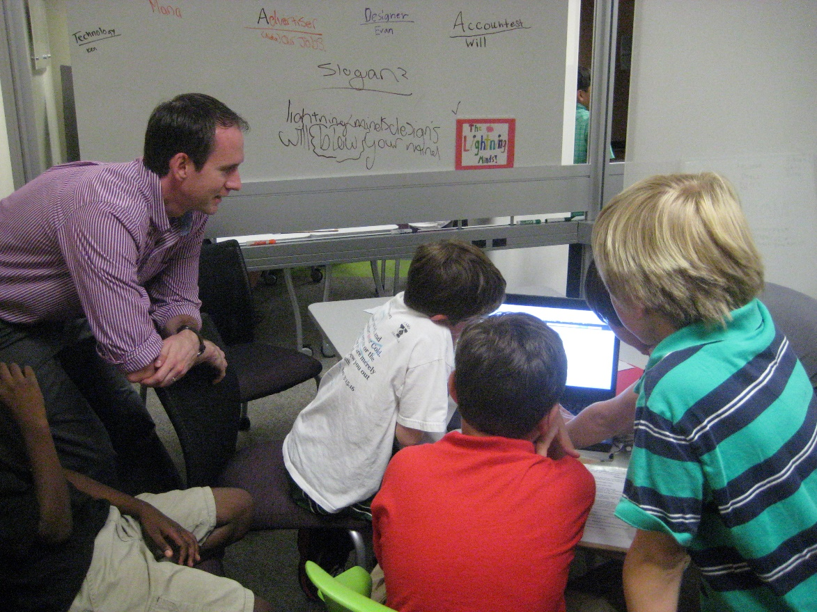
Department of Education
© Brain Wrinkles

Slide 14
Departments
2. Department of Human Resources (DHR): One of the largest state agencies; services include assisting the elderly, family and children’s services, and mental health.
3. Department of Public Safety (DPS): Responds to natural and manmade disasters, helps public safety agencies reduce crime, and enforces traffic laws.
4. Department of Transportation (DOT): Oversees work and construction on roads and bridges, provides transportation information, issues drivers licenses.
© Brain Wrinkles

Slide 15
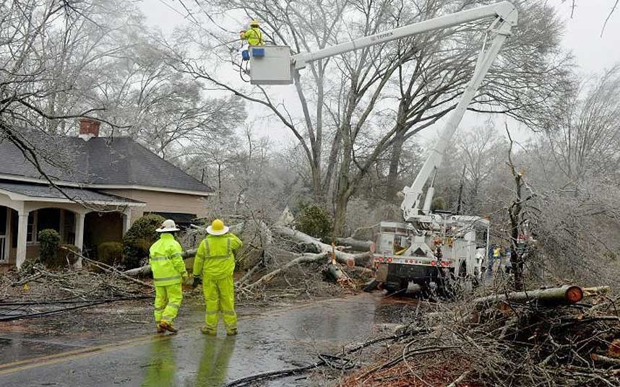
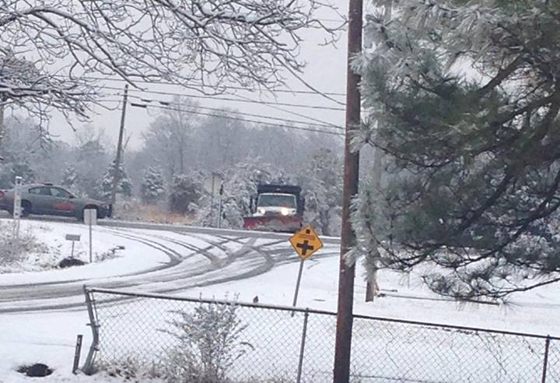
Department of Public Safety
© Brain Wrinkles

Slide 16
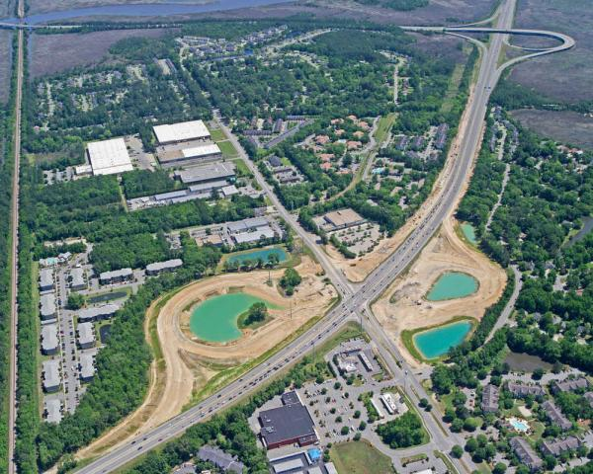
=
Department of Transportation
© Brain Wrinkles

Slide 17
Departments
5. Department of Economic Development (DED): Supports the economy through local and international business expansion, technology development, tourism, film, and music.
6. Department of Natural Resources (DNR): Helps protect and conserve resources by managing historic sites, state parks, and fishing and wildlife areas; runs programs to keep Georgia’s air and water clean.
© Brain Wrinkles

Slide 18
Department of Economic Development
© Brain Wrinkles

Slide 19
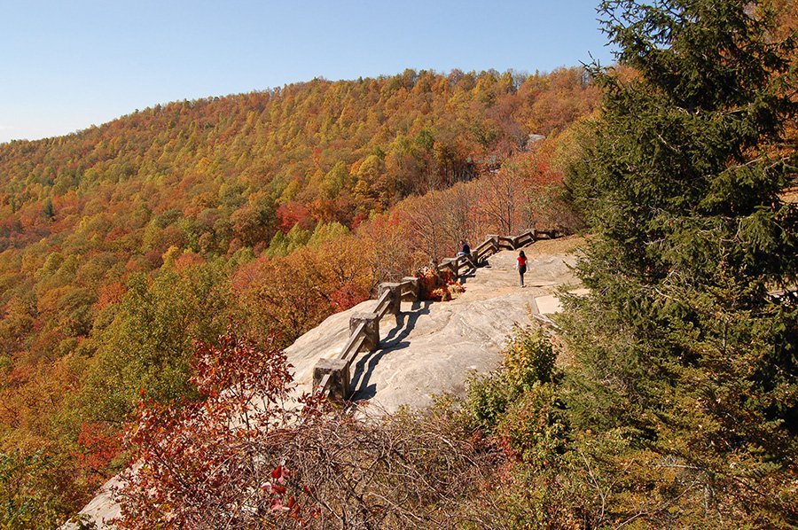
Department of Natural
Resources
© Brain Wrinkles

