Slide 1
1950s & 1960s:
Civil
Rights
SS8H11
© 2015 Brain Wrinkles

Slide 2
Standards
SS8H11 Evaluate the role of Georgia in the modern civil rights movement.
a. Explain Georgia’s response to Brown vs. Board of Education including the 1956 flag and the Sibley Commission.
b. Describe the role of individuals (Martin Luther King, Jr. and John Lewis), groups (SNCC and SCLC) and events (Albany Movement and March on Washington) in the Civil Rights Movement.
c. Explain the resistance to the 1964 Civil Right Act, emphasizing the role of Lester Maddox.
© 2015 Brain Wrinkles

Slide 3
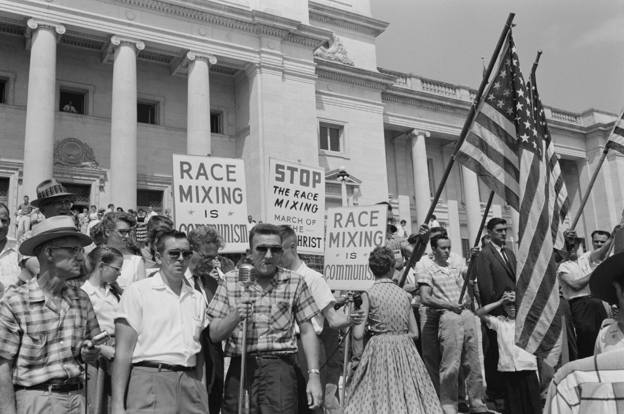
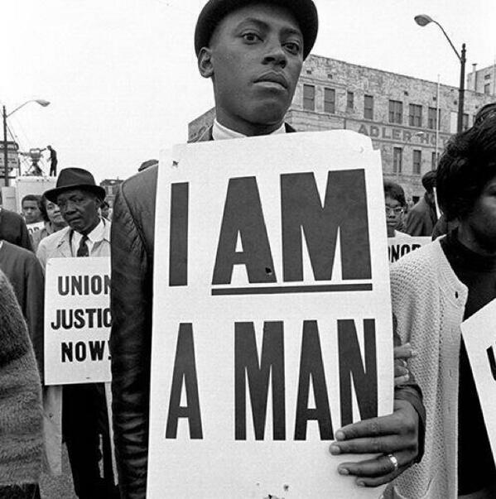
Civil Rights
Throughout the US’ history, many African Americans were treated like second-class citizens, especially in the South.
They were forced to live in segregated housing, attend segregated movies, and use segregated facilities such as restrooms, water fountains, and waiting rooms.
During the Civil Rights Movement, African Americans fought against racial discrimination and segregation.
© 2015 Brain Wrinkles

Slide 4
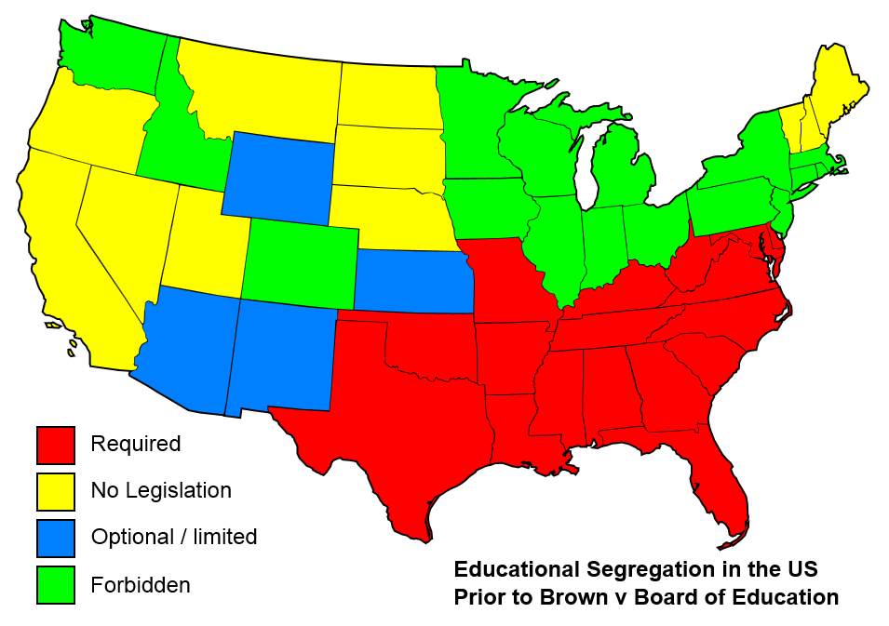
Brown vs. BOE
Schools were another place where blacks and whites were segregated.
In 1954, Oliver Brown sued the board of education in Topeka, Kansas because the schools were segregated.
His third grade daughter, Linda, had to travel one mile to get to her black school, even though the white school was a lot closer.
© 2015 Brain Wrinkles

Slide 5
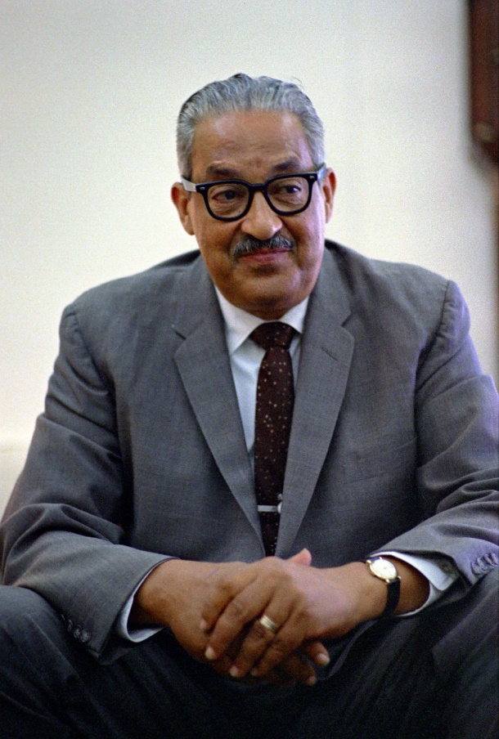
Brown vs. BOE
Linda Brown’s lawyer was Thurgood Marshall.
He argued the case before the U.S. Supreme Court that having separate schools violated the 14th Amendment to the Constitution.
In 1967, Thurgood Marshall became the first African American Supreme Court Justice.
© 2015 Brain Wrinkles

Slide 6
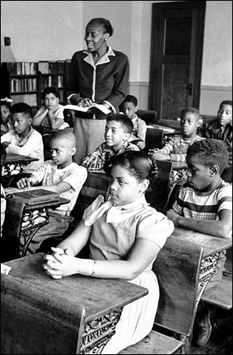
Brown v. BOE
The US Supreme Court heard the case Brown v. Board of Education.
In 1954, the Supreme Court handed down a unanimous decision that greatly impacted Georgia and the rest of the South.
The court ruled that segregation was unconstitutional, and public schools across America began to integrate.
Linda Brown
© 2015 Brain Wrinkles

Slide 7
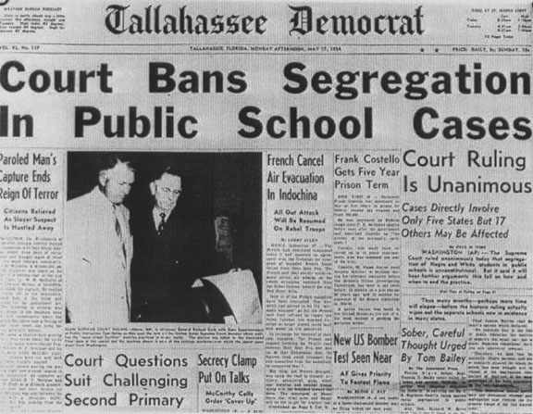
Brown v. BOE
This case overturned the earlier 1896 Plessy v. Ferguson case that declared the “separate but equal” doctrine.
Even though all 9 of the justices ruled that any separation would not be equal, many southern states refused to segregate their schools.
Georgia’s governor, Herman Talmadge, strongly opposed the decision and encouraged Georgia’s legislature to rebel against the ruling.
© 2015 Brain Wrinkles

Slide 8
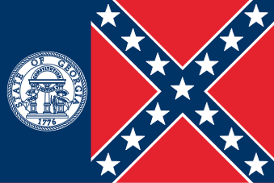
1956 State Flag
In 1956, the Georgia Assembly approved the state’s most controversial flag.
The 1956 flag greatly offended African Americans and progressive whites because two-thirds of it looked like a Confederate battle flag.
Most people believed the legislature’s new flag decision to be symbolic of Georgia’s resistance to the federal government’s integration laws.
The flag represented Georgia for 45 years until it was finally replaced in 2001.
1956 to 2001 Flag
© 2015 Brain Wrinkles

Slide 9
Sibley Commission
After schools were forced to segregate by law in 1954, Georgia refused to cooperate.
In 1960, a commission was formed by Atlanta banker John Sibley that held public hearings to see how Georgians felt about integration.
The Sibley Commission found that 2 out of 3 Georgians would rather see schools closed that integrated.
As a result, the commission recommended that each local district decide the desegregation matter for itself.
© 2015 Brain Wrinkles

Slide 10
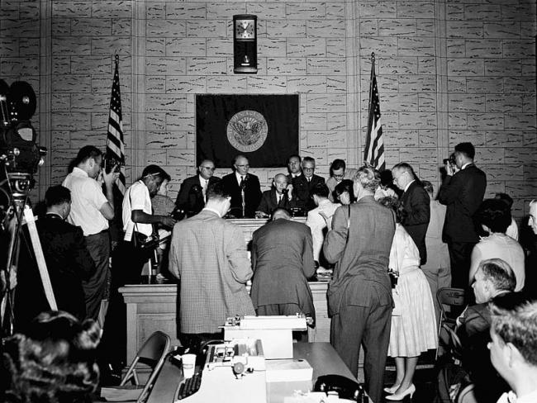
The Sibley Commission allowed local districts to make their own decision regarding desegregation, which made the process of integration very slow.
© 2015 Brain Wrinkles

Slide 11
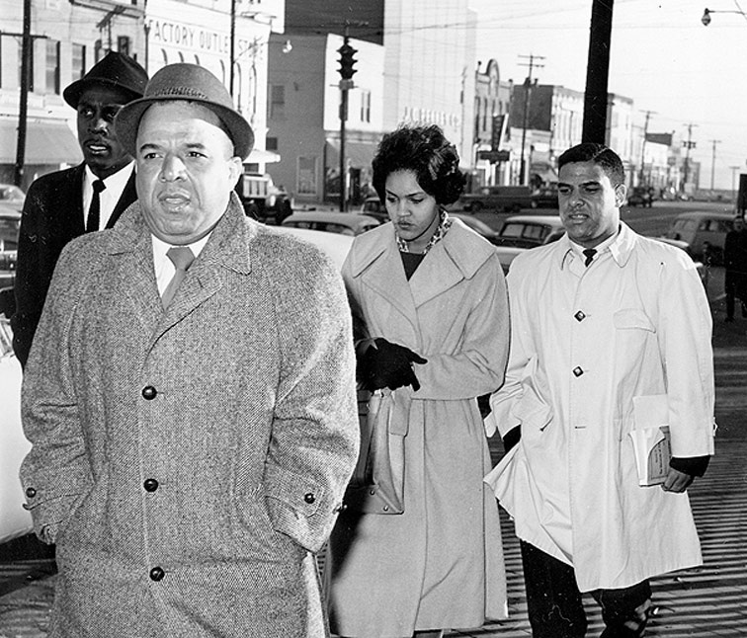
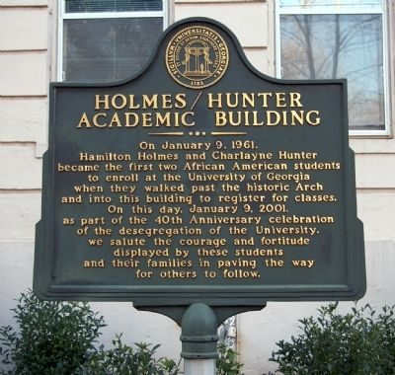
UGA Integration
African American students Charlayne Hunter and Hamilton Holmes both applied several times to the University of Georgia.
Each time, their applications were denied because the university was “full”.
They took their case to court and the school was integrated in 1961 under an order by the US District Court in Athens.
When they entered, they were treated harshly by the student population and an angry crowd threw bricks through Hunter’s dorm window.
Both Hunter and Holmes graduated and went on to have very successful careers.
Holmes was a surgeon and Hunter is a writer/journalist.
© 2015 Brain Wrinkles

Slide 12
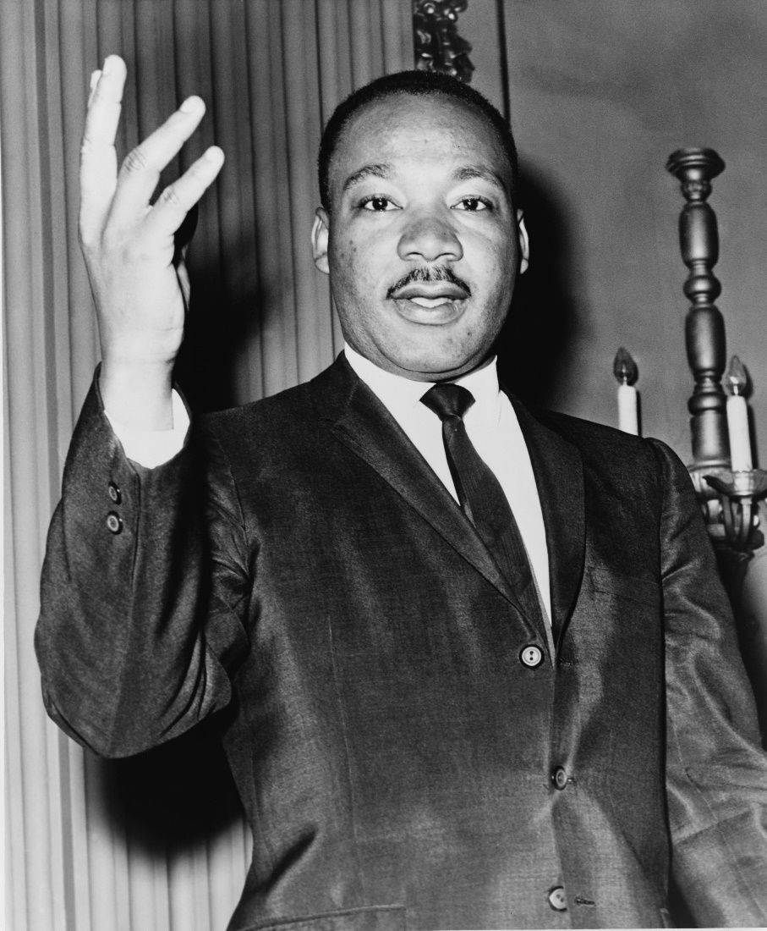
Martin Luther King, Jr.
Martin Luther King, Jr. was born (1929) and raised in Atlanta.
King graduated from Morehouse with a Ph.D. and became an ordained Baptist minister.
He became a national hero and the recognized leader of the Civil Rights Movement after successfully leading the Montgomery Bus Boycott.
The Boycott ended when the Supreme Court ordered Montgomery to desegregate their public transportation.
© 2015 Brain Wrinkles

Slide 13
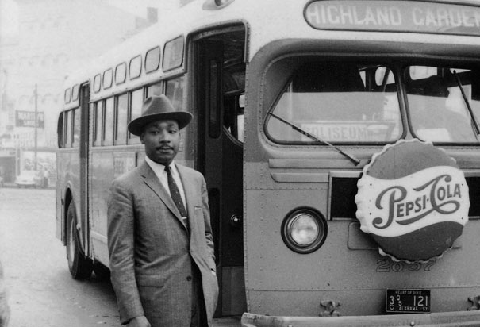
Martin Luther King, Jr.
King was an extremely gifted man who preached nonviolent civil disobedience against unfair laws.
He believed that African Americans could gain their rights by protesting, but that the protests should be peaceful.
King formed a group called the Southern Christian Leadership Conference to lead anti-discrimination marches and protests throughout the South.
© 2015 Brain Wrinkles

Slide 14
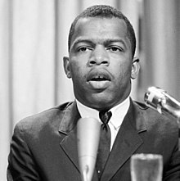
John Lewis.
Lewis was born as Sharecropper in Alabama and became a prominent part of the Civil Rights movement
Lewis was active in the 1960’s sit-ins to protest Jim Crow Laws and participated in Freedom rides in the early 1960’s.
He became the chair of the new organization, SNCC, that devoted to gaining more civil rights for African Americans
Lewis was also a keynote speaker in the March on Washington alongside Martin Luther King, Jr. as well as the Leader of the March in Selma
John Lewis, 1964
© 2015 Brain Wrinkles

Slide 15
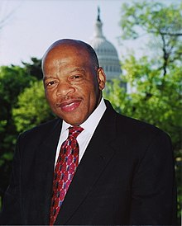
John Lewis.
After the Civil Rights Movement he continued to fight for Civil Right by helping Africans Americans register to vote.
Lewis was elected to Atlanta City Council in 1981 where he advocated for ethics in government and community preservation.
In November of 1986, Lewis was elected to United States Congress from the 5th Congressional District and continues to serve today.
John Lewis, 2017
© 2015 Brain Wrinkles

Slide 16
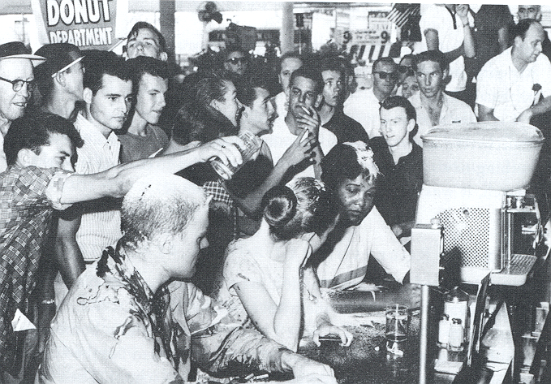
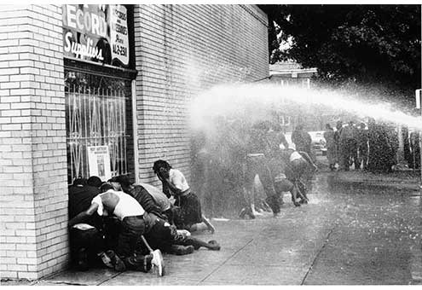
Nonviolent Protests
King believed that African Americans would win their rights quicker if they refused to engage in violence.
Many African Americans and some whites held nonviolent marches and boycotts across the country.
At times, the nonviolent actions from civil rights workers received violent reactions from white people.
As people around the nation saw peaceful protestors being beaten by angry mobs and policemen, the movement gained support.
© 2015 Brain Wrinkles

Slide 17
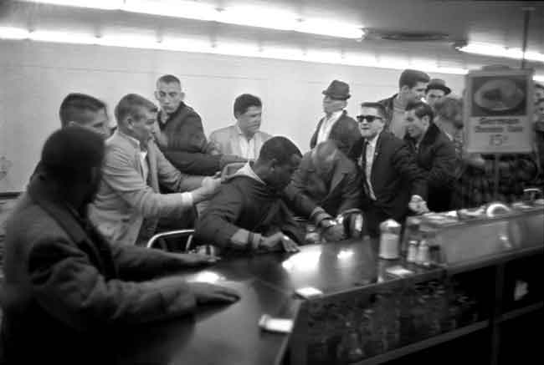
SNCC
By the 1960s, the Civil Rights Movement was well underway and was gaining fast momentum.
King’s strategy of peaceful protest was adopted by a group of college students who formed the Student Non-Violent Coordinating Committee (SNCC) in 1960.
SNCC used sit-ins at lunch counters where they refused to move in order to boycott businesses that wouldn’t serve blacks.
SNCC also helped promote voter registration throughout the South.
© 2015 Brain Wrinkles

Slide 18
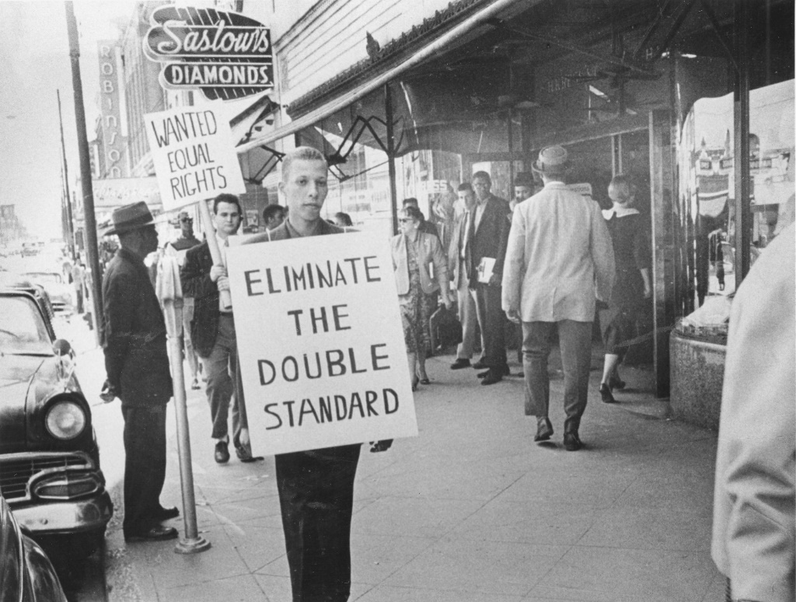
SCLC
Founded in 1957 in Montgomery, AL after the Bus Boycotts by Martin Luther King, Jr.
When King left Birmingham the headquarters was moved to Atlanta with him.
SCLC planned rallies, marches, boycotts, and filed law suits against civil rights violations.
One of the major protests that SCLC planned was the Albany Movement, they wanted to create opportunities for economic improvement for African Americans in the south.
Today SCLC focuses on causes such as health care, prison reform, fair treatment of refugees, and job site safety
© 2015 Brain Wrinkles

Slide 19
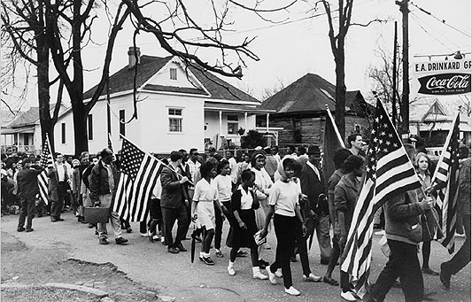
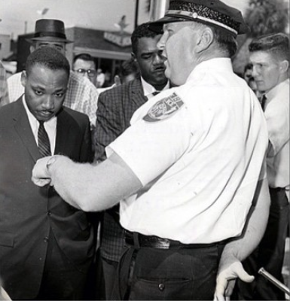
Albany Movement
From fall 1961 to summer 1962, a desegregation movement involving the NAACP, SCLC, and SNCC took place in Albany, Georgia.
The movement’s goal was to end all types of segregation in Albany (transportation, schools, libraries, hospitals, restaurants, juries, etc.) through mass protests, sit-ins, and boycotts.
The police wanted to avoid negative publicity, so they arrested over 500 protestors.
© 2015 Brain Wrinkles

Slide 20
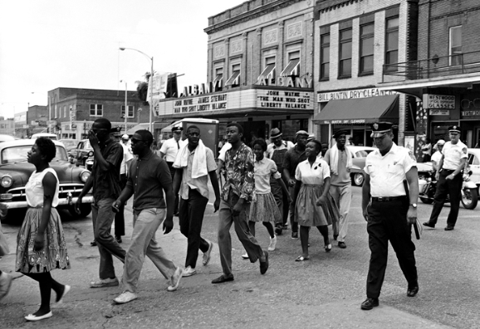
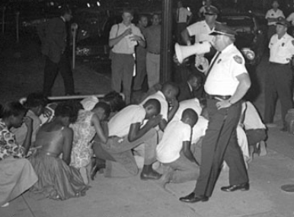
Albany Movement
Martin Luther King, Jr. came to Albany to lend his support and bring national attention to the cause; however, he was also arrested.
Desegregation efforts failed in Albany, and King said it was because the groups tried to do too many things, instead of focusing on one aspect of segregation.
It was considered more of a learning experience than a success, but the city did eventually desegregate.
© 2015 Brain Wrinkles

Slide 21
March on Washington
In 1963, Martin Luther King, Jr. led more than 250,000 people on a civil rights march in Washington, D.C.
They called on President Kennedy and Congress to pass a law that guaranteed equal rights and quality education for all citizens.
King gave his famous “I Have a Dream” speech at the gathering, inspiring Americans to strive for a world where black and white children could play together in peace.
© 2015 Brain Wrinkles

Slide 22
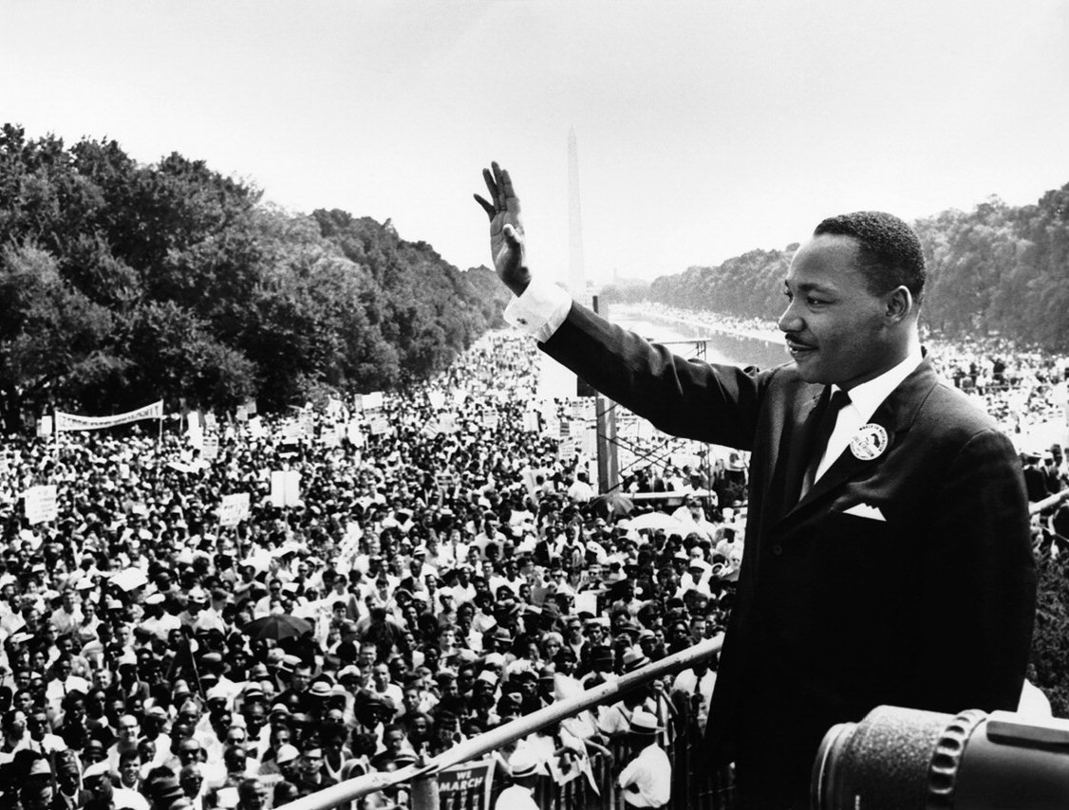
“I have a dream that my four little children will one day live in a nation where they will not be judged by the color of their skin but by the content of their character.”
Martin Luther King, Jr.
© 2015 Brain Wrinkles

Slide 23
Civil Rights Act
The March on Washington got the government’s attention and Congress soon passed the Civil Rights Act in 1964.
This law banned discrimination against any American because of that person’s race, color, or religion.
The law enforced the desegregation of public places.
It also said that people of all races, male and female, should have the equal opportunity to get a job.
© 2015 Brain Wrinkles

Slide 24
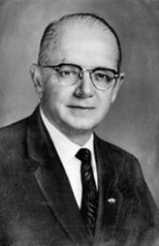
Lester Maddox
Lester Maddox became a public figure when he chose to close his Atlanta restaurant rather than comply with the Civil Rights Act and serve African Americans.
In 1966, he was elected as Georgia’s governor, despite being a strict segregationist.
Maddox surprised many people by hiring more African Americans into office than any governor before him.
Lester Maddox
© 2015 Brain Wrinkles

Slide 25
Lester Maddox
Maddox also integrated the Georgia State Patrol and GBI.
As governor, he supported prison reform and increased spending for Georgia’s universities.
Maddox also started “People’s Day”, a monthly event where average citizens could come talk to him in the Governor’s office.
He kept representatives nearby to help the people solve their problems.
© 2015 Brain Wrinkles

